Slide 1


HINDUSTHAN COLLEGE OF ENGINEERING AND TECHNOLOGY
Approved by AICTE, New Delhi |Affiliated to Anna University|An Autonomous Institution
Accredited with ‘A++’ Grade by NAAC
Accredited by NBA (ECE, MECH, EEE, IT, CSE, AERO, AUTO, CIVIL & MCT) VALLEY CAMPUS, POLLACHI HIGHWAY , COIMBATORE – 641 032
AUTOMATED CAR WASHING SYSTEM USING PLC
GUIDE NAME
Dr.R.Rajesh Kanna,M.E,Ph.D., Associate Professor Department of Electrical and Electronics Engineering BATCH DETAILS
20105005 – ARUN C
20105011 – DHANUSH M
20105013 – DINESH S
20105016 – ELAVARSAN E
19EE7901 – PROJECT PHASE -1
DEPARTMENT OF ELECTRICAL AND ELECTRONICS ENGINEERING
29/11/2023
1

Slide 2
ABSTRACT
This project presents the design and implementation of a PLC-based car washer system that leverages advanced automation technologies to enhance the efficiency and precision of the car cleaning process.
The system incorporates a Programmable Logic Controller (PLC) as the central control unit, orchestrating the coordinated functioning of a conveyor, water motor for cleaning, motor brush for water swiping, and proximity sensors for control.
The conveyor system serves as the primary transport mechanism, facilitating the seamless movement of the car through the washing station.
A water motor, controlled by the PLC, efficiently dispenses cleaning agents onto the car's surface,
ensuring thorough and consistent cleaning.
A motorized brush, synchronized with the conveyor, sweeps across the car, providing mechanical scrubbing for enhanced cleaning efficacy.
19EE8901 - PROJECT WORK - PHASE 2 PRESENTATION
2

Slide 3
INTRODUCTION
In the ever-evolving landscape of automotive maintenance and services, the demand for efficient and automated solutions continues to rise.
This project introduces a cutting-edge PLC-based car washer system designed to streamline and enhance the car cleaning process.
By integrating advanced technologies such as a Programmable Logic Controller (PLC), conveyor system, water motor, motorized brush, and proximity sensors, the system aims to revolutionize traditional car washing methodologies.
Traditional car wash systems often rely on manual labor or basic automation, lacking the precision
and adaptability required for diverse vehicle models.
The introduction of a PLC as the central control unit brings a new level of sophistication to the car washing process.
19EE8901 - PROJECT WORK - PHASE 2 PRESENTATION
3

Slide 4
INTRODUCTION
The conveyor system acts as the backbone of the car washer, enabling the smooth transportation of vehicles through the cleaning station.
The water motor, under the PLC's control, optimally dispenses cleaning agents, while the motorized brush enhances the scrubbing action for a thorough cleaning experience.
The inclusion of proximity sensors adds an intelligent dimension to the system, allowing real-time detection of the car's presence and dimensions, thereby customizing the cleaning process dynamically.
3 This project aims to address the limitations of traditional car washing methods by providing an
automated and adaptable solution.
The integration of PLC technology not only ensures precision in cleaning but also opens avenues for customization, making the system versatile enough to cater to a variety of car models and sizes.
19EE8901 - PROJECT WORK - PHASE 2 PRESENTATION
4

Slide 5
LITERATURE SURVEY
S.NO | TITLE OF THE JOURNAL | AUTHORS NAME | REFERENCE | YEAR
1 | IEEE International Conference on power, control, signal and Instrumentation Engineering | Ragini Gaikwad, Sidesh Mohite Mayuri Kharat, Jayendra Thakur | PLC based Automatic Car Washing System Using Proximity Sensors | 2017
2 | IEEE Conference on Systems, Process and Control(ICSPC 2016) | Anam Abid, Tahir Hasan, Taimoor Baig and Abdulla Jadoon | Design and Development of Automatic Carwash System | 2016
3 | IOSR Journal of Engineering ISSN(e): 2250-3021, ISSN (p):2278-8719 PP 45-51 | Asif Iqbal Shaikh, Shyam L.B Singh, Prof. N.B.Bankhele, Prof.P.D.Aher | Automatic Car Washing System Using PLC & SCADA | 2019

Slide 6
LITERATURE SURVEY
S.NO | TITLE OF THE JOURNAL | AUTHORS NAME | REFERNCE | YEAR
4 | International Journal of Latest Technology in Engineering, Management& Applied Science Volume VII, Issue V | Antara Desmukh, Kumari Shikha, Tanya Jha.Prof.A.R more | PLC Base Car Washing System. | May 2018
5 | IJCRT., vol 11, issue 4., ISSN: 2320-2882 | Manthan joshi | Automated car washing system | April 2023

Slide 7
BLOCK DIAGRAM & DESCRIPTION
POWER SUPPLY
CONVEYOR
PLC
PROXIMITY SENSOR
WATER
MOTOR
BLOCK DIAGRAM OF AUTOMATED CAR WASHING SYSTEM USING PLC

Slide 8
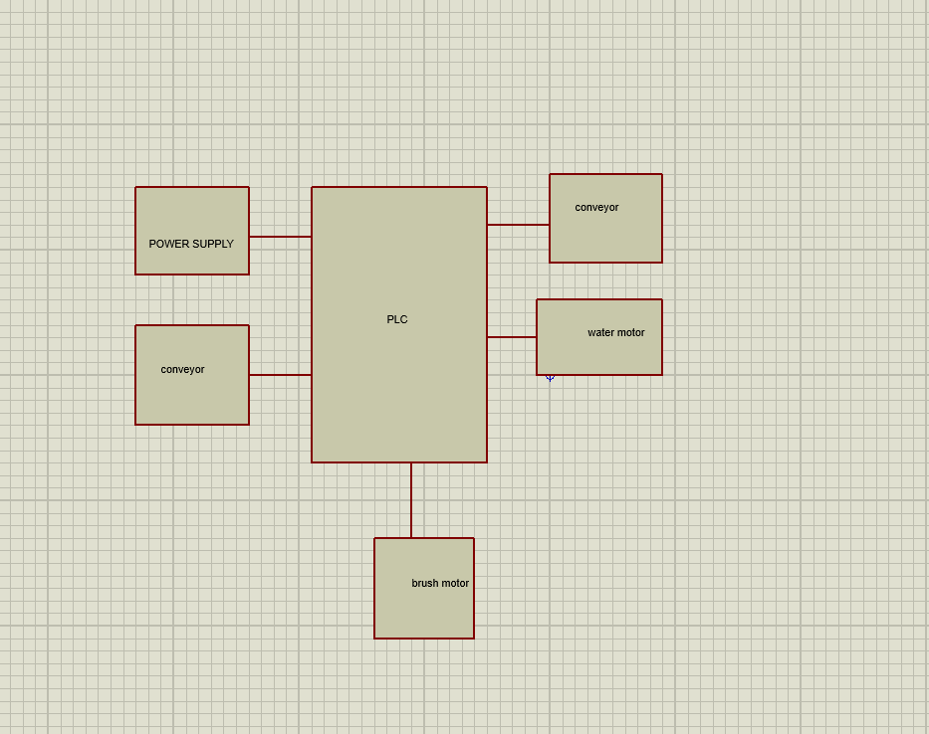
CIRCUIT DIAGRAM & DESCRIPTION
CIRCUIT DIAGRAM OF AUTOMATED CAR WASHING SYSTEM USING PLC

Slide 9
TEST RESULT
Conduct extensive testing to verify the functionality of the system.
Identify and resolve any hardware or software issues, ensuring the system operates smoothly.
Safety and Compliance Ensure the system complies with safety standards and regulations in the industrial environment.
Implement safety features, interlocks, and emergency stop mechanisms to protect personnel and equipment.
Test the system as a whole, including the interaction between the conveyor, PLC control, and Numatics
actuators.
Verify that the system meets the defined project requirements and objectives.

Slide 10
TEST RESULT
Conveyor motor testing: When the switch of the PLC is on the conveyor motor will be driven to carry the car to proximity sensor detection and next followed by the water sprayer. Conveyors pull or push a car through the wash tunnel. There are two types of conveyors: over-under and surface conveyors. Most conveyor systems have small rollers that pop up behind the wheel once it is on the conveyor. The roller pushes the wheel forward, causing the car to roll along through the tunnel, which is the term used to describe the long bay used for exterior-only and full-service systems.
Proximity sensor testing: Proximity Sensors, in PLC automation, are usually used in detecting the presence or absence of objects made of varying materials. They do so WITHOUT making contact.
Sometimes they are called “proximity switches” because the output is binary, HIGH or LOW—just like a
switch. When the car reaches the proximity sensor its is ready to stop and start to automatically wash the car.

Slide 11
TEST RESULT
Testing of water pump motor: When the car reaches the proximity sensor it starts to move to the water sprayer and it starts to sprinkle on the car for 20 seconds and after 20 seconds the sprinkler will be turned off and move to the next process.
Testing of brush motor: When the car reaches the final washing section the conveyor moves to the brush motor and the brush motor starts operated and the brush motor starts to rotate and clean the car for 20 seconds .After the operation of the brush motor for 20 seconds completes the brush motor turn off automatically.
Thermal Management and Heat Dissipation Analysis: Elaborate on the thermal management testing conducted to evaluate the heat dissipation capabilities of the electric motors, focusing on the analysis of temperature profiles, effectiveness, and the impact of temperature fluctuations on the car' performance and battery longevity.

Slide 12
BUDGET/COST
SI.No | COMPONENTS | COST
1. | SCHNEIDER-PLC | 7499
2. | CONVEYOR BELT | 999
3. | PROXIMITY SENSOR | 950
4. | WATER PUMP | 249
5. | DC BRUSH MOTOR | 700
6. | 12V BATTERY | 1400
7. | CONVEYOR KIT | 3500
8. | WIPER BRUSH | 80
9. | MODEL METAL CAR | 200
10. | WIRES AND CONNECTORS | 699
 | TOTAL COST | 16,276

Slide 13
CONCLUSION & FUTURE EXTENSION
The successful deployment and testing of the PLC-based car washer validate its reliability, precision,
and adaptability.
As a result, this project stands as a testament to the potential of automation in enhancing not only the efficiency of car washing processes but also the overall customer experience in the automotive service industry.
The scalable design and intelligent automation introduced in this system pave the way for future
advancements and innovations in automated vehicle cleaning technologies. The challenge for the feature has been analysed and evaluated because more effort has gone into developing automated system to improve productivity than has gone into the appropriate matching of people and technology.
The versatility of the robots used in all the applications is important, as in applying that capability efficiently

Slide 14


QUERIES ???

